Slide 1
Applied Sciences Faculty Management Information Systems
Dr. Yakup BAKIŞ
Notes:
Hi everyone! My name is Yakup.

Slide 2
Chapter 1
Introduction to web development
Notes:
Hello everyone again.
Today, we will move one step forward and start understanding how the web actually works behind the scenes.
Last week we talked about the Internet and the Web. Today, we will focus on:
the client–server model
types of websites
and the basics of HTML.

Slide 3
Key Components of Client-server Model
Communication Protocol:
The communication between the client and the server is usually governed by specific protocols.
For example, HTTP/HTTPS for web browsing, FTP for file transfers, or SMTP for email communication.
These protocols define how the data is structured, transmitted, and received.
Notes:
Let’s understand what really happens when you open a website.
When you open a website, a communication process starts between the client and the server.
This communication is controlled by protocols such as:
HTTP or HTTPS for web pages
FTP for file transfer
SMTP for email communication.
These protocols define how data is sent, structured, and received.
First, you type a URL into your browser. The browser acts as the client and sends a request to a server somewhere on the Internet.
The server processes this request and sends back the website’s files — usually HTML for structure, CSS for design, and JavaScript for interaction.
Finally, the browser renders these files and displays the webpage on your screen.
This simple communication between client and server is the foundation of the entire web.

Slide 4
Client (Browser) &Server-side scripting languages
Client (Browser)
Server-side
HTML for structure
CSS for design
JavaScript
• ASP.NET
• JSP
• PHP
• ColdFusion
• Ruby
• Perl
• Python
Notes:
On the client side, we have what the user sees and interacts with in the browser.
On the server side, we have the logic, data processing, and databases.
Server-side technologies may include:
PHP
Python
Ruby
Java
and others.
But in this course, we will mainly focus on the front-end, because it gives visible results quickly. Since the browser understands HTML, CSS, and JavaScript, this course will start by learning HTML, the language of the web.
• HTML is a means of telling a web browser how to display a page.
• Standard language for creating web pages and web applications.
• HTML is the acronym for :
Hypertext Markup language
You can start with the client and server side by saying: "On the client side, we have what the user sees—the browser displaying content. On the server side, we have the logic and data processing, sending what’s needed back to the client." Then introduce HTML: "HTML is the structure of the web page. HTML5, the latest standard, added more multimedia and modern features." After that: "The front-end is what the user interacts with—HTML, CSS, and JavaScript. The back-end is where the data and logic live—servers, databases, and processing." Finally: "CSS is what makes everything look good—styling the layout, colors, and design." This sequence will give them a clear flow of concepts!
Back-end includes languages like PHP, Python, or Node.js, and it handles data processing, server logic, and databases—it’s the brain behind the scenes. Front-end uses HTML for structure, CSS for styling, and JavaScript for interactivity—it’s the face users see. The back-end is powerful but more complex, while the front-end is immediate and visual. Each has alternatives—for instance, back-end could use Java or Ruby, and front-end has frameworks like React or Vue. We focus on front-end because it gives you visible results quickly and teaches core web principles.

Slide 5
Web browsers
• Chrome
• Internet Explorer
• Firefox
• Safari
• Opera
Notes:
Common web browsers include:
Chrome
Firefox
Safari
Opera
and Internet Explorer.
These browsers are the tools that display web pages to users.

Slide 6
Types of Websites
Static Websites
A static website consists of web pages with fixed content.
The content of these pages is delivered exactly as stored, meaning it doesn’t change unless manually updated by a developer.
Dynamic Websites
A dynamic website is more complex and provides interactive features, with content that can change based on user interactions or other factors.
This type of site can pull data from databases and adjust its content accordingly.
Notes:
There are two main types of websites.
Static websites
Fixed content
Simple structure
No server-side processing
Fast loading
Limited interactivity.
Dynamic websites
Interactive content
Server-side scripting
Database integration
More complex structure.
For example:
Blogs and portfolios → static
E-commerce and social media → dynamic.

Slide 7
Static Websites Characteristics
Fixed content
Simple structure
No server-side processing
Faster loading
Limited Interactivity
Dynamic Websites Characteristics
Interactive content
Server-side scripting
Database integration
Complexity

Slide 8
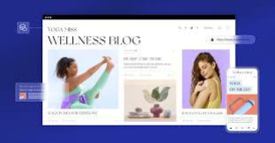

Types of Websites
Static Websites uses
Personal blogs
Portfolio websites
Business websites
Dynamic Websites uses
E-commerce websites
Social media platform
Banking websites

Slide 9
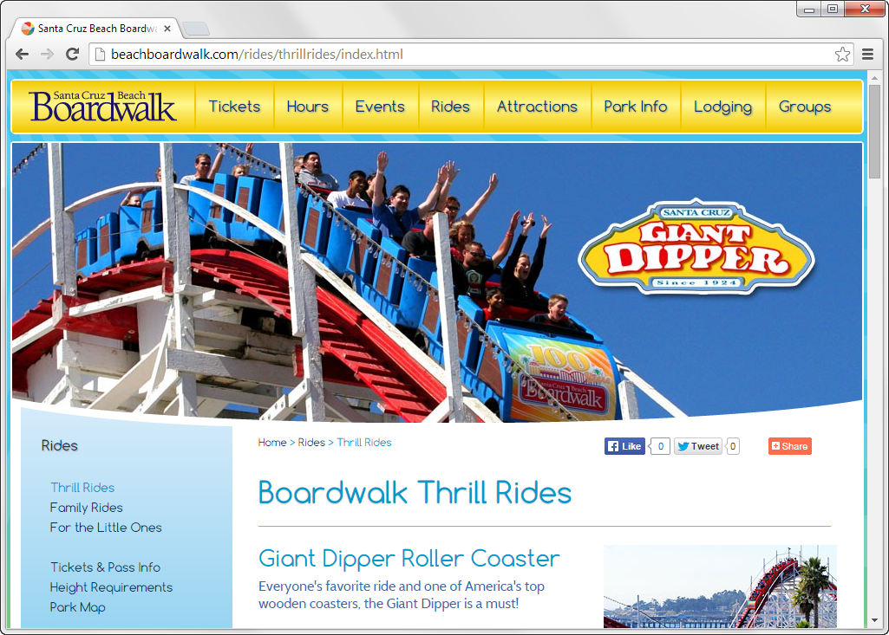
A static web page

Slide 10
How a web server processes a static web page
Notes:
A static page is sent directly from the server to the browser as an HTML file.
A dynamic page is created by:
application servers
databases
and server-side logic
before being sent to the client.

Slide 11
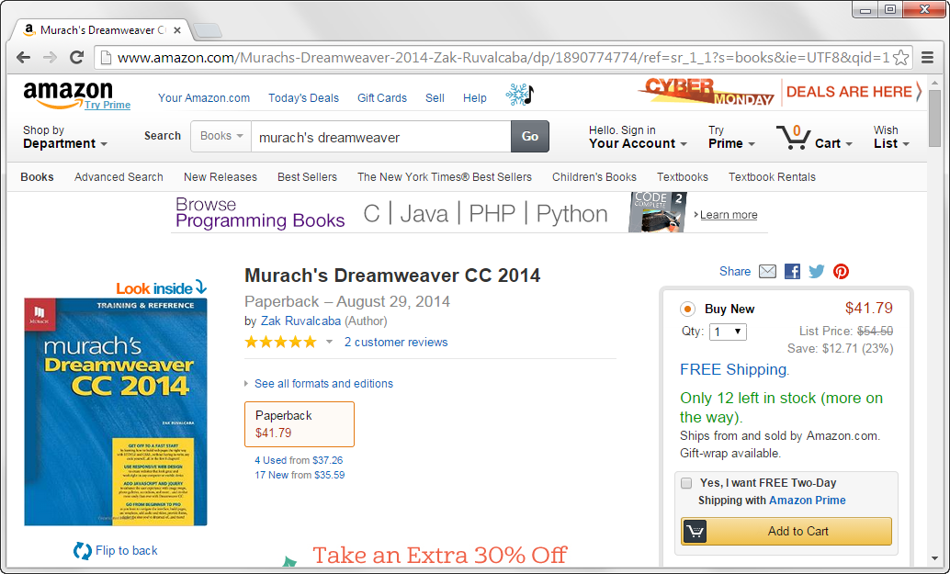
A dynamic web page at amazon.com

Slide 12
How a web server processes a dynamic web page

Slide 13
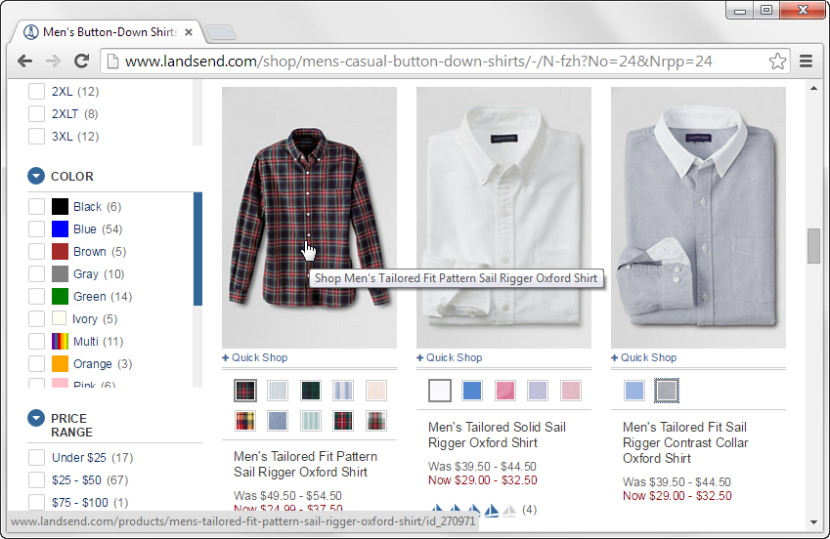
A web page with image swaps and rollovers

Slide 14
How JavaScript fits into this architecture
Notes:
JavaScript works together with HTML in the browser.
The server sends:
HTML
JavaScript files
and the browser runs the JavaScript to create interactive behavior.

Slide 15
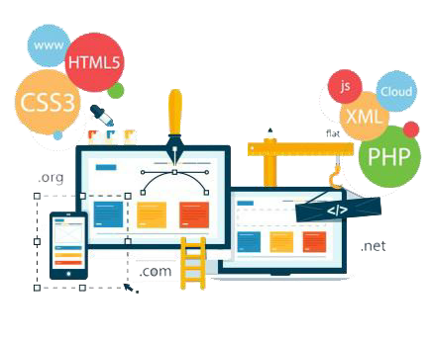
Web Designing
Web designing is the process of creating the visual appearance and layout of websites.
It involves a combination of graphic design, user interface (UI) design, and user experience (UX) design to produce aesthetically pleasing and functional websites
Notes:
Web design is the process of creating the visual layout and appearance of a website.
It combines:
graphic design
user interface (UI)
user experience (UX)
to produce functional and attractive websites.

Slide 16
Web Development Categories
Front-End Development (Client-Side)
This focuses on what the user interacts with directly in a web browser.
It involves creating the visual aspects of the website such as layout, design, and navigation.
Front-end developers use HTML (Hypertext Markup Language) to structure the content, CSS (Cascading Style Sheets) for styling and layout, and JavaScript to add interactivity and dynamic elements.
The goal is to provide a seamless and engaging user experience.
Notes:
Front-end
What the user sees
Uses HTML, CSS, JavaScript.
Back-end
Server logic and databases
Uses PHP, Python, Java, databases.
Full-stack
Works on both sides of development.

Slide 17
Web Development Categories
Back-End Development (Server-Side)
This involves the behind-the-scenes operations of a website, including managing databases, user authentication, and server-side logic.
Back-end developers typically work with server-side languages such as PHP, Python, Ruby, Java, and databases like MySQL, PostgreSQL, or MongoDB.
The back end is responsible for processing requests made by the front end, retrieving or storing data, and sending the appropriate response back to the client.

Slide 18
Web Development Categories
Full-Stack Development
A full-stack developer works on both the front-end and back-end of a website or web application.
They are proficient in both client-side and server-side technologies, allowing them to handle the entire development process.

Slide 19
Technologies of Web Development
HTML (Hypertext Markup Language)
HTML is the backbone of every web page.
This is the standard language used to create and structure content on the web.
It defines the structure of a webpage using tags and elements, like headings, paragraphs, images, and links.
Notes:
HTML is the backbone of every web page.
It:
structures content
uses tags and elements
defines headings, paragraphs, images, and links. 3rd_ Week_Client_Server_and_HTM…
Important idea:
HTML is not a programming language. It is a structure language.

Slide 20
Technologies of Web Development
CSS (Cascading Style Sheets)
CSS controls the look and feel of the website.
It styles the HTML elements, including setting colors, fonts, spacing, and positioning, and ensures a consistent layout across different screen sizes and devices.

Slide 21
Technologies of Web Development
JavaScript
JavaScript adds interactivity to websites.
It can manipulate HTML and CSS dynamically, responding to user actions such as clicks or form submissions, and allowing for features like animations, real-time updates, and interactive elements.

Slide 22
Examples of the Client-Server Model
Web Browsing
When you open a website, your browser (client) sends a request to a web server.
The server processes the request and returns the webpage, which is displayed in the browser.
Email
Your email client (Outlook, Gmail, etc.) sends requests to the email server, which retrieves or sends email messages.
Database Access
A database client (e.g., an application) requests data from a database server, which processes the query and returns the data.

Slide 23
What is HTML?
HTML = HyperText Markup Language
The basic building block of every web page
Defines the structure of content on the web
Uses tags to describe elements (title, paragraph, image, link)
Works together with CSS (design) and JavaScript (interaction)
HTML is not a programming language — it is a structure language.
Notes:
HTML is the language that creates the skeleton of a web page. It tells the browser what is a title, what is a paragraph, and where images or links should appear.
HTML alone cannot make a site beautiful or interactive. For design we use CSS, and for behavior we use JavaScript.
So think of HTML as the structure, CSS as the style, and JavaScript as the brain of the website.

