Slide 1
Applied Sciences Faculty Management Information Systems UMI_224_COMPUTER NETWORK SYSTEMS
Dr. Yakup BAKIŞ

Slide 2
About Me
Yakup Bakış
PhD in Physics with research in nanotechnology, semiconductor devices, and energy systems.
Teaching experience in Electrical & Electronics Engineering.
Courses taught: Electronic Circuits, Electromagnetic Theory, Circuit Analysis, and Electronics Laboratories.
Developer of real-world POS and EV charging software systems and the full web infrastructure of sarjpos.com.
This course focuses on practical, real-world networking systems and digital infrastructure.
Notes:
I hold a PhD in Physics with academic and research experience in electronics, nanotechnology, and semiconductor devices.
My research includes work on organic OFET structures, inorganic nanorod-based systems, and energy storage materials.
I previously taught courses such as Electronic Circuits, Electromagnetic Theory, Circuit Analysis, and Basic Electronics Laboratories in engineering programs.
In addition to academic teaching, I actively develop real-world software and hardware systems, including POS-based EV charging infrastructures, backend server architectures, and web platforms.
I designed and coded the full infrastructure of sarjpos.com and have long-term experience in electronics, embedded systems, and software integration.
My goal in this course is to combine engineering thinking, real-world development, and practical web technologies to help you build meaningful and functional digital systems. I may come from a different academic background, but this allows me to approach software and web systems from a broader engineering perspective.

Slide 3
Now it’s your turn!
Please introduce yourself:
Your name
What is the internet app you use most often in your daily life?
What's your first experience with Wi-Fi access? 🙂

Slide 4
About the Class (What we will learn)
UMI_203_COMPUTER NETWORK SYSTEMS
We will learn:
Network architectures and Fundamentals of computer networks and the Internet
layered models (OSI & TCP/IP)
Core protocols and data communication mechanisms
IP addressing, routing, and local area networking
Wireless, mobile, and cloud networking concepts
Network security, performance, and troubleshooting
The role of networking in modern organizations and digital transformation
Designing basic network solutions for business environments
Notes:
This course explains how the Internet and computer networks function. We will study the main layers of networking, the protocols used in communication, and the technologies behind modern digital systems. By the end of the course, you will clearly understand how data travels from one device to another.

Slide 5
What the class does:
Provides fundamental, marketable knowledge about how computer networks and the Internet operate in real-world environments.
Enables you to understand, design, and manage small-scale network structures used in organizations.
Introduces core networking concepts such as protocols, addressing, routing, wireless communication, and cloud connectivity.
Builds awareness of network security, performance, and troubleshooting in modern digital systems.
Connects networking technologies with business needs, digital transformation, and organizational efficiency.
By the end of this course, you WILL be able to analyze and design a basic network solution for a real organization.

Slide 6
Our Focus in This Course
We focus on understanding how computer networks and the Internet operate in real-world environments.
You will learn the core architecture, protocols, and data communication mechanisms before moving to advanced networking systems.
This foundation prepares you for:
Network design and administration
Cybersecurity and secure communication
Cloud computing and enterprise networking
Advanced networking and system management courses
Students who want deeper technical expertise can continue with advanced courses in networking, cybersecurity, or distributed systems.
Notes:
In this course, you will learn: how the Internet is structured, how devices communicate, how data is transmitted reliably, and how networks are secured. These are core skills for IT and MIS careers.

Slide 7
Why This Course Matters for Your Career
Computer networks are the backbone of today’s digital world. Almost every company, institution, and technology system depends on reliable and secure networking.
Basic networking knowledge provides real, marketable technical awareness even at an entry level.
This course gives you the foundation to:
Understand how the Internet and organizational networks operate
Analyze network performance, security, and connectivity issues
Communicate effectively with IT and technical teams
Take the first step toward careers in:
Network and system administration
Cybersecurity
Cloud computing and IT infrastructure
Software and technology fields
By the end of this course, you will be able to analyze and design a basic network solution for a real organization.
Notes:
Today, almost everything starts on the web. Whether you become an engineer, a designer, or start your own business, you will need to present yourself digitally.
This course is not only about coding. It is about giving you a skill that you can actually use in real life.
And by the end of this semester, you will build a real website that you can proudly show to others.

Slide 8
The Big Picture: How the Internet Really Works
Every time you open a website, a complex journey begins.
Your device connects to a local network, then to an Internet Service Provider, and finally to distant servers across the world.
During this journey:
Data is divided into packets
Protocols control communication
Routers decide the path
Security mechanisms protect information
This course is about understanding and mastering this journey.
Notes:
Before going into technical details, we first need to understand the big picture. The Internet is not a single machine. It is a global system of interconnected networks working together to move data across the world.

Slide 9
Networking Skills in the Modern IT World
Today’s technology careers are built on networked systems.
Even if you are not a programmer, understanding networks allows you to:
Work effectively with IT and software teams
Understand cybersecurity risks
Manage cloud-based systems
Support digital transformation in organizations
Networking knowledge is a core professional advantage in the digital economy.
Notes:
Networking knowledge is used in many careers: system administration, cybersecurity, cloud computing, software development, and IT management. So this course is not only theoretical — it is directly connected to your future jobs.

Slide 10
Let’s Observe the Internet in Action
When a single webpage loads:
Dozens or even hundreds of network requests are sent
Different servers respond with data
Security checks and protocols operate instantly
Question: ➡ Why does something so simple require such complex communication?
This question will guide our entire semester.
Next week, we begin answering this question
Notes:
Right now, we are only looking at a simple web page… But in the background, a very complex communication is actually happening.
Look carefully… When a single page loads, dozens of separate files are requested from the server.
Now, if we look at the numbers at the bottom:
38 requests
1.2 MB of data transferred
About one second to load
So what we call “the Internet” is not a single connection, but hundreds of small data exchanges happening very quickly.
The browser sends a request to a server,and the server sends back a response.
In fact, the entire web is built on these two ideas: Request and Response.
If we look at the status code:
200 means everything is OK.
If it were 404, it would mean the page does not exist.
Also, a slow page is not only about Internet speed.
First, the DNS must be found. Then a connection is established. Then the server prepares and sends a response.
In this course, we will learn exactly where this delay comes from and how network communication really works.
Now, look at the address bar.
You can see it says “Not secure.” This means the site is not encrypted with HTTPS.
If there were a lock icon here, the data between the browser and the server would be encrypted.
Later in this course, we will understand the cryptography and security protocols that work behind this lock.
Today, we only saw the final result.
But throughout this semester, we will answer one fundamental question step by step:
How does a piece of data leave your device and reach a server on the other side of the world?

Slide 11
Grading Structure
Grading:
30% Mid-term
Core networking fundamentals
40% Final exam
Comprehensive
10% Two Quizzes
10% Assignment
10% Final Project

Slide 12
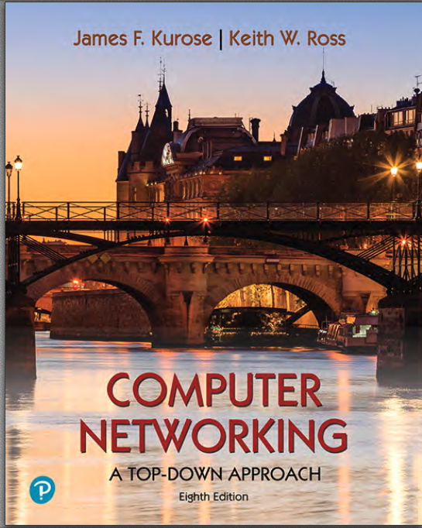
Class Format
We’ll be following the curriculum in the textbook:
Computer Networking A Top-Down Approach (James W. Kurose, Keith W. Ross)

Slide 13
Quizzes
We will have two small quizzes to reinforce material and let you know what you need to study.
When we have them I will announce them at least a week ahead of time in class, and on the website. I’ll also send out an e-mail.
Your lowest quiz score will be dropped, and you’ll be graded on your better two. If you miss a quiz, that will be the one dropped.

Slide 14
Attendance
University attendance policies will be applied in this course.
As an instructor, I am required to follow these regulations.
Attendance is not directly graded, but it is strongly recommended for your learning success.
You are responsible for understanding all material covered in class.
Lab time is an important opportunity to practice and should be used effectively.

Slide 15
Any Questions?
From here, we will begin with the fundamentals of how computer networks and the Internet work, and then move toward protocols, security, and real-world network design.
I am always happy to answer your questions about the course or the topics we study.
Please never hesitate to ask questions during or after class.
I look forward to a productive and engaging semester together.

