Slide 1
Applied Sciences Faculty Management Information Systems
Dr. Yakup BAKIŞ

Slide 2
Chapter 1
Computer Networks and
the Internet

Slide 3
Internet structure: a “network of networks”
1.3.3 A Network of Networks
Hosts connect to Internet via access Internet Service Providers (ISPs)
residential, enterprise (company, university, commercial) ISPs
Access ISPs in turn must be interconnected
so that any two hosts can send packets to each other
Resulting network of networks is very complex
evolution was driven by economics and national policies
Let’s take a stepwise approach to describe current Internet structure
Notes:
Now we move to the big question: how is the Internet itself structured as a network of networks?
The Internet is not a single network owned by one company. It is a network of networks. End systems (hosts) connect to the Internet through access ISPs—for example, a residential ISP for home users, an enterprise ISP for companies/universities, or a mobile ISP for cellular users.
Hosts connect to the Internet through access ISPs. These can be residential ISPs, enterprise ISPs, or mobile ISPs.
However, connecting hosts to an access ISP is only the first step. For the Internet to work, access ISPs must be interconnected so that any two hosts—anywhere in the world—can exchange packets.
But access ISPs must also be interconnected, so that any two hosts can send packets to each other.
The result is a complex structure, and its evolution is driven not only by technology, but also by economics and policy.
This global interconnection is complex, and it evolves not only because of technology, but also because of economics and national policy. In other words, money and business agreements strongly shape how networks connect.
Key takeaway: The Internet works because many independent networks agree to connect and exchange traffic.

Slide 4
Internet structure: a “network of networks”
1.3.3 A Network of Networks
Question: given millions of access ISPs, how to connect them together?
…
access
net
…
access
net
access
net
access
net
access
net
access
net
access
net
…
…
access
net
access
net
access
net
access
net
access
net
…
access
net
access
net
access
net
access
net
…
Notes:
Imagine there are millions of access networks. The main engineering question is: How can we connect them so everyone can reach everyone?
At first, it sounds like a purely technical problem. But in reality, it is also an economic problem, because building and maintaining connections costs money.

Slide 5
Internet structure: a “network of networks”
1.3.3 A Network of Networks
Question: given millions of access ISPs, how to connect them together?
…
access
net
…
access
net
access
net
access
net
…
…
access
net
access
net
access
net
…
connecting each access ISP to each other directly doesn’t scale: O(N²) connections.
…
…
access
net
access
net
…
access
net
access
net
access
net
…
…
access
net
access
net
access
net
access
net
…
Notes:
A naïve solution is to connect every access ISP directly to every other access ISP. But this does not scale. If there are N access ISPs, the number of required connections grows roughly like N².
That would be extremely expensive and physically unrealistic. So the Internet cannot be built as a full mesh between all access networks.
Key takeaway: Scalability constraints force the Internet to be organized in levels and agreements.

Slide 6
Internet structure: a “network of networks”
1.3.3 A Network of Networks
Option: connect each access ISP to one global transit ISP?
Customer and provider ISPs have economic agreement.
…
access
net
…
access
net
access
net
access
net
access
net
access
net
access
net
…
…
global ISP
access
net
access
net
access
net
access
net
access
net
…
access
net
access
net
access
net
access
net
…
Notes:
A more realistic idea is: each access ISP connects to a global transit ISP. This transit ISP has a large network of routers and links and provides global connectivity. …
In this model, the access ISP pays the global ISP for carrying its traffic. That payment relationship is called a customer–provider relationship.
This is important: Internet structure is not only about cables and routers—it is also about who pays whom.

Slide 7
Internet structure: a “network of networks”
1.3.3 A Network of Networks
But if one global ISP is viable business, there will be competitors ….
…
access
net
…
access
net
access
net
access
net
access
net
access
net
ISP A
access
net
…
…
access
net
ISP B
access
net
ISP C
access
net
access
net
access
net
…
access
net
access
net
access
net
access
net
…
Notes:
If operating a global transit ISP is profitable, other companies will build competing global ISPs. So we will have multiple global ISPs.
But then another requirement appears: these global ISPs must also connect to each other. Otherwise, an access ISP connected to one global ISP could not communicate with access ISPs connected to another global ISP.
Key takeaway: Competition creates multiple “backbone” networks, and they must interconnect.

Slide 8
Internet structure: a “network of networks”
1.3.3 A Network of Networks
But if one global ISP is viable business, there will be competitors …. who will want to be connected
Internet exchange point
…
access
net
…
access
net
access
net
access
net
access
net
IXP
access
net
access
net
ISP A
…
…
access
net
IXP
ISP B
access
net
ISP C
access
net
access
net
access
net
peering link
…
access
net
access
net
access
net
access
net
…
Notes:
When ISPs connect to exchange traffic directly, we call it peering. Many peering relationships are settlement-free, meaning the two ISPs do not pay each other; they simply agree to exchange traffic because it benefits both sides.
An Internet Exchange Point (IXP) is a physical location where many ISPs meet and connect (often through switches). Instead of building separate direct links to each ISP, an ISP can connect to an IXP and peer with multiple networks more efficiently.
Key takeaway: IXPs reduce cost and increase connectivity by enabling many peering connections in one place.

Slide 9
Internet structure: a “network of networks”
1.3.3 A Network of Networks
… and regional networks may arise to connect access nets to ISPs
…
access
net
…
access
net
access
net
access
net
access
net
IXP
access
net
access
net
ISP A
…
…
access
net
IXP
ISP B
access
net
ISP C
access
net
access
net
access
net
regional ISP
…
access
net
access
net
access
net
access
net
…
Notes:
In practice, there are often regional ISPs between access ISPs and large global backbones. Access ISPs connect to regional ISPs, and regional ISPs connect to higher-level ISPs.
This multi-level structure is more realistic because no single ISP has routers in every city worldwide. Regional ISPs provide coverage within a region and connect upward for global reach.

Slide 10
Internet structure: a “network of networks”
1.3.3 A Network of Networks
… and content provider networks (e.g., Google, Microsoft, Akamai) may run their own network, to bring services, content close to end users
…
access
net
…
access
net
access
net
access
net
access
net
IXP
access
net
access
net
ISP A
…
…
Content provider network
access
net
IXP
ISP B
access
net
ISP C
access
net
access
net
access
net
regional ISP
…
access
net
access
net
access
net
access
net
…
Notes:
In today’s Internet, large content providers often run their own networks. Examples include Google and Microsoft.
They build private backbones and connect their data centers around the world. Their goal is to bring content closer to users, improve performance, and reduce dependence on upper-tier transit networks.
This is closely related to the idea of CDNs (Content Delivery Networks): deliver content from locations near the user to reduce delay and improve user experience.
Key takeaway: Modern Internet structure is shaped by big content providers, not only traditional ISPs.

Slide 11
Internet structure: a “network of networks”
1.3.3 A Network of Networks
Tier 1 ISP
Tier 1 ISP
Google
IXP
IXP
IXP
Regional ISP
Regional ISP
access
ISP
access
ISP
access
ISP
access
ISP
access
ISP
access
ISP
access
ISP
access
ISP
At “center”: small # of well-connected large networks
“tier-1” commercial ISPs (e.g., Level 3, Sprint, AT&T, NTT), national & international coverage
content provider networks (e.g., Google, Facebook): private network that connects its data centers to Internet, often bypassing tier-1, regional ISPs
Notes:
At the center of the Internet, there are a small number of very well-connected large networks. These include tier-1 commercial ISPs and large content provider networks.
Tier-1 ISPs provide national and international coverage and interconnect with one another. Content provider networks may sometimes bypass parts of the hierarchy by peering directly with lower-tier ISPs where possible.

Slide 12
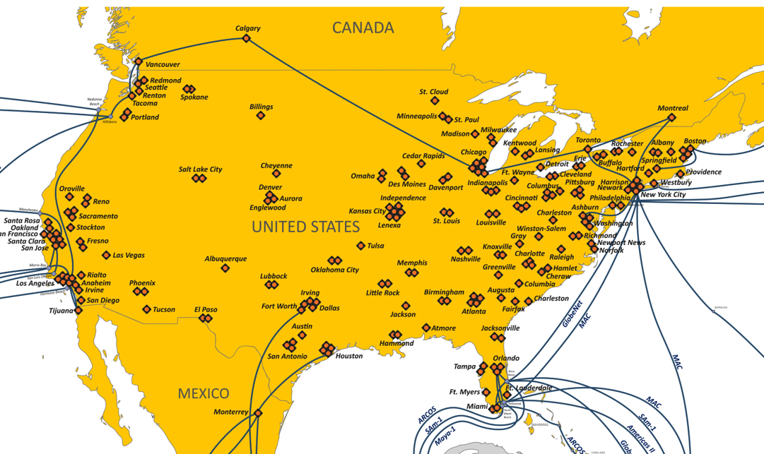
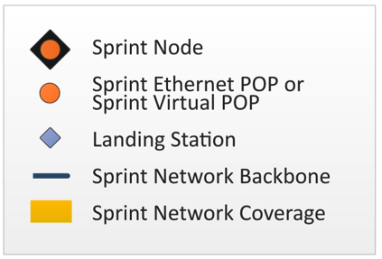
Tier-1 ISP Network map: Sprint (2019)
1.3.3 A Network of Networks
POP: point-of-presence
to/from other Sprint PoPS
links to peering networks
…
…
…
…
…
links to/from Sprint customer networks
Notes:
This map gives a real example of how large a tier-1 ISP network can be. A key concept here is POP (Point of Presence).
A POP is a physical location where an ISP has routers and can connect with customers or peers. In other words, POPs are important “connection hubs” that help an ISP provide wide-area coverage.
Key takeaway: The Internet is physically distributed, and tier-1 networks are built from many POP locations connected by high-speed links.

