Slide 1
Applied Sciences Faculty
Management Information Systems
Dr. Yakup BAKIŞ
Notes:
Good morning everyone.
Last week, we talked about how the Internet works in general.
Today, we move one layer higher.
We will begin to understand the Application Layer,
which is the layer closest to the user.
When you open a website, send an email, or use Instagram, you are using the Application Layer.
This is the part of networking that you actually see and use every day.

Slide 2
Chapter 2
Application Layer
Notes:
Today I am going to present Chapter 2, which is the Application Layer. In computer networking, the application layer is the part closest to the user, because this is where network applications such as the Web, e-mail, messaging, and video services work. In this presentation, I will explain the main ideas of this chapter in a simple and organized way. I will talk about how applications communicate, what kinds of architectures they use, and what transport services they need. I will also introduce important protocols such as HTTP, SMTP, IMAP, and DNS. My goal is to show that network applications are the reason why computer networks are useful in daily life.

Slide 3

Application Layer: Overview
P2P applications
video streaming and content distribution networks
socket programming with UDP and TCP
Principles of network applications
Web and HTTP
E-mail, SMTP, IMAP
The Domain Name System DNS

Slide 4
DNS: Domain Name System
people: many identifiers:
  SSN, name, passport #
Internet hosts, routers:
  IP address (32 bit) - used for addressing datagrams
  “name”, e.g., cs.umass.edu - used by humans
Q: how to map between IP address and name, and vice versa ?
Domain Name System:
distributed database implemented in hierarchy of many name servers
application-layer protocol: hosts, name servers communicate to resolve names (address/name translation)
  note: core Internet function, implemented as application-layer protocol
  complexity at network’s “edge”

Slide 5
DNS: services, structure
DNS services
hostname to IP address translation
host aliasing
  canonical, alias names
mail server aliasing
load distribution
  replicated Web servers: many IP addresses correspond to one name
Q: Why not centralize DNS?
single point of failure
traffic volume
distant centralized database
maintenance
A: doesn‘t scale!
Comcast DNS servers alone: 600B DNS queries per day

Slide 6
DNS: a distributed, hierarchical database
Root DNS Servers
Root
…
…
.com DNS servers
.org DNS servers
.edu DNS servers
Top Level Domain
…
…
…
…
yahoo.com
DNS servers
amazon.com
DNS servers
pbs.org
DNS servers
nyu.edu
DNS servers
umass.edu
DNS servers
Authoritative
Client wants IP address for www.amazon.com; 1st approximation:
client queries root server to find .com DNS server
client queries .com DNS server to get amazon.com DNS server
client queries amazon.com DNS server to get IP address for www.amazon.com

Slide 7
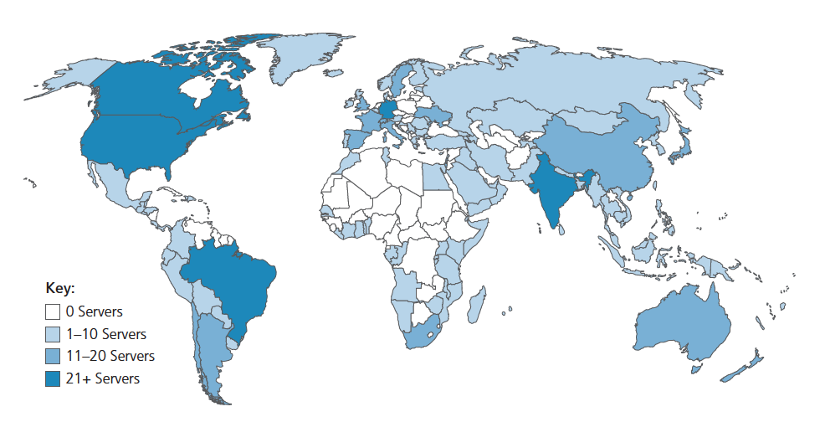
DNS: root name servers
official, contact-of-last-resort by name servers that can not resolve name
incredibly important Internet function
  Internet couldn’t function without it!
  DNSSEC – provides security (authentication and message integrity)
ICANN (Internet Corporation for Assigned Names and Numbers) manages root DNS domain
13 logical root name “servers” worldwide each “server” replicated many times (~200 servers in US)

Slide 8
TLD: authoritative servers
Top-Level Domain (TLD) servers:
  responsible for .com, .org, .net, .edu, .aero, .jobs, .museums, and all top-level country domains, e.g.: .cn, .uk, .fr, .ca, .jp
  Network Solutions: authoritative registry for .com, .net TLD
  Educause: .edu TLD
Authoritative DNS servers:
  organization’s own DNS server(s), providing authoritative hostname to IP mappings for organization’s named hosts
  can be maintained by organization or service provider

Slide 9
Local DNS name servers
does not strictly belong to hierarchy
each ISP (residential ISP, company, university) has one
  also called “default name server”
when host makes DNS query, query is sent to its local DNS server
  has local cache of recent name-to-address translation pairs (but may be out of date!)
  acts as proxy, forwards query into hierarchy

Slide 10


DNS name resolution: iterated query
root DNS server
Example: host at engineering.nyu.edu wants IP address for gaia.cs.umass.edu
2
3
TLD DNS server
Iterated query:
contacted server replies with name of server to contact
“I don’t know this name, but ask this server”
1
4
8
5
requesting host at
engineering.nyu.edu
local DNS server
dns.nyu.edu
6
gaia.cs.umass.edu
7
authoritative DNS server
dns.cs.umass.edu

Slide 11
DNS name resolution: recursive query
root DNS server
Example: host at engineering.nyu.edu wants IP address for gaia.cs.umass.edu
2
3
Recursive query:
puts burden of name resolution on contacted name server
heavy load at upper levels of hierarchy?
7
6
1
TLD DNS server
8
requesting host at
engineering.nyu.edu
local DNS server
dns.nyu.edu
5
4
gaia.cs.umass.edu
authoritative DNS server
dns.cs.umass.edu

Slide 12
Caching, Updating DNS Records
once (any) name server learns mapping, it caches mapping
  cache entries timeout (disappear) after some time (TTL)
  TLD servers typically cached in local name servers
    thus root name servers not often visited
cached entries may be out-of-date (best-effort name-to-address translation!)
  if name host changes IP address, may not be known Internet-wide until all TTLs expire!
update/notify mechanisms proposed IETF standard
  RFC 2136

Slide 13
DNS records
DNS: distributed database storing resource records (RR)
RR format: (name, value, type, ttl)
type=A
  name is hostname
  value is IP address
type=CNAME
  name is alias name for some “canonical” (the real) name
  www.ibm.com is really servereast.backup2.ibm.com
  value is canonical name
type=NS
  name is domain (e.g., foo.com)
  value is hostname of authoritative name server for this domain
type=MX
  value is name of mailserver associated with name

Slide 14
DNS protocol messages
DNS query and reply messages, both have same format:
2 bytes
2 bytes
message header:
identification: 16 bit # for query, reply to query uses same #
flags:
  query or reply
  recursion desired
  recursion available
  reply is authoritative
identification
flags
# questions
# answer RRs
# authority RRs
# additional RRs
questions (variable # of questions)
answers (variable # of RRs)
authority (variable # of RRs)
additional info (variable # of RRs)

Slide 15
DNS protocol messages
DNS query and reply messages, both have same format:
2 bytes
2 bytes
identification
flags
# questions
# answer RRs
# authority RRs
# additional RRs
name, type fields for a query
questions (variable # of questions)
RRs in response to query
answers (variable # of RRs)
records for authoritative servers
authority (variable # of RRs)
additional “ helpful” info that may be used
additional info (variable # of RRs)

Slide 16
Inserting records into DNS
Example: new startup “Network Utopia”
register name networkuptopia.com at DNS registrar (e.g., Network Solutions)
  provide names, IP addresses of authoritative name server (primary and secondary)
  registrar inserts NS, A RRs into .com TLD server:
  (networkutopia.com, dns1.networkutopia.com, NS)
  (dns1.networkutopia.com, 212.212.212.1, A)
create authoritative server locally with IP address 212.212.212.1
  type A record for www.networkuptopia.com
  type MX record for networkutopia.com

Slide 17
DNS security
DDoS attacks
bombard root servers with traffic
  not successful to date
  traffic filtering
  local DNS servers cache IPs of TLD servers, allowing root server bypass
bombard TLD servers
  potentially more dangerous
Redirect attacks
man-in-middle
  intercept DNS queries
DNS poisoning
  send bogus relies to DNS server, which caches
Exploit DNS for DDoS
send queries with spoofed source address: target IP
requires amplification
DNSSEC
[RFC 4033]

Slide 18
Application Layer: Overview
P2P applications
video streaming and content distribution networks
socket programming with UDP and TCP
Principles of network applications
Web and HTTP
E-mail, SMTP, IMAP
The Domain Name System DNS

Slide 19









Peer-to-peer (P2P) architecture
no always-on server
arbitrary end systems directly communicate
peers request service from other peers, provide service in return to other peers
  self scalability – new peers bring new service capacity, and new service demands
peers are intermittently connected and change IP addresses
  complex management
examples: P2P file sharing (BitTorrent), streaming (KanKan), VoIP (Skype)
mobile network
national or global ISP
local or regional ISP
home network
content
provider
network
datacenter
network
enterprise
network

Slide 20
File distribution: client-server vs P2P
Q: how much time to distribute file (size F) from one server to N peers?
  peer upload/download capacity is limited resource
u_{s}: server upload capacity
d_{i}: peer i download capacity
file, size F
u_{s}
u₁
d₁
u₂
server
d₂
d_{i}
u_{N}
network (with abundant
bandwidth)
u_{i}
d_{N}
u_{i}: peer i upload capacity

Slide 21

File distribution time: client-server
server transmission: must sequentially send (upload) N file copies:
  time to send one copy: F/u_{s}
  time to send N copies: NF/u_{s}
F
u_{s}
d_{i}
network
client: each client must download file copy
  d_{min} = min client download rate
  min client download time: F/d_{min}
u_{i}
time to distribute F
to N clients using
client-server approach
D_{c-s} > max{NF/u_{s,},F/d_{min}}
increases linearly in N

Slide 22
File distribution time: P2P
server transmission: must upload at least one copy:
  time to send one copy: F/u_{s}
F
u_{s}
client: each client must download file copy
  min client download time: F/d_{min}
d_{i}
network
u_{i}
clients: as aggregate must download NF bits
  max upload rate (limiting max download rate) is u_{s} + Σu_{i}
time to distribute F
to N clients using
P2P approach
D_{P2P} > max{F/u_{s,},F/d_{min,},NF/(u_{s} + Σu_{i})}
increases linearly in N …
… but so does this, as each peer brings service capacity

Slide 23
Client-server vs. P2P: example
client upload rate = u, F/u = 1 hour, u_{s} = 10u, d_{min} ≥ u_{s}

Slide 24





P2P file distribution: BitTorrent
file divided into 256Kb chunks
peers in torrent send/receive file chunks
tracker: tracks peers
participating in torrent
torrent: group of peers exchanging chunks of a file
Alice arrives …
… obtains list
of peers from tracker
… and begins exchanging
file chunks with peers in torrent

Slide 25


P2P file distribution: BitTorrent
peer joining torrent:
  has no chunks, but will accumulate them over time from other peers
  registers with tracker to get list of peers, connects to subset of peers (“neighbors”)
while downloading, peer uploads chunks to other peers
peer may change peers with whom it exchanges chunks
churn: peers may come and go
once peer has entire file, it may (selfishly) leave or (altruistically) remain in torrent

Slide 26
BitTorrent: requesting, sending file chunks
Requesting chunks:
at any given time, different peers have different subsets of file chunks
periodically, Alice asks each peer for list of chunks that they have
Alice requests missing chunks from peers, rarest first
Sending chunks: tit-for-tat
Alice sends chunks to those four peers currently sending her chunks at highest rate
  other peers are choked by Alice (do not receive chunks from her)
  re-evaluate top 4 every10 secs
every 30 secs: randomly select another peer, starts sending chunks
  “optimistically unchoke” this peer
  newly chosen peer may join top 4

Slide 27


BitTorrent: tit-for-tat
(1) Alice “optimistically unchokes” Bob
(2) Alice becomes one of Bob’s top-four providers; Bob reciprocates
(3) Bob becomes one of Alice’s top-four providers
higher upload rate: find better trading partners, get file faster !

